Slide 1
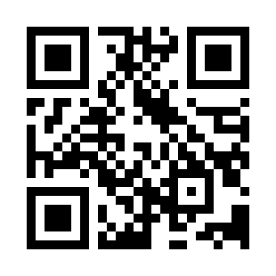

Introduction to Software Estimation Quiz
https://bit.ly/39UcHpH

